Slide 1
Exception Handling
Said Nabi

Slide 2
Introduction
Basic input validation using if, else if, else or other selection statements.
Useful for preventing foreseeable errors like
  Invalid menu selection
  Negative input for age
  Division by zero (checked before performing division)
This keeps the program safe from known issues.

Slide 3
Introduction
Some problems cannot be predicted or prevented using conditions.
  Memory allocation failure
  File not found
  Internet connection failure
  Array index out of range (often runtime)
  Hardware failure (e.g., disk read error)
  External library throwing an exception
These are runtime errors and beyond the programmer’s control.

Slide 4
Introduction
Exception Handling
  Used for handling unexpected runtime errors
  Helps separate error-handling code from regular logic
  Ensures the program doesn’t crash abruptly
  Maintains the flow of execution
  Allows recovery or graceful exit

Slide 5
Exception Handling Overview
Keywords
  try
    Include codes in which exceptions might occur
  throw
    Trigger an exception
  catch
    Represent types of exceptions the catch can handle

Slide 6
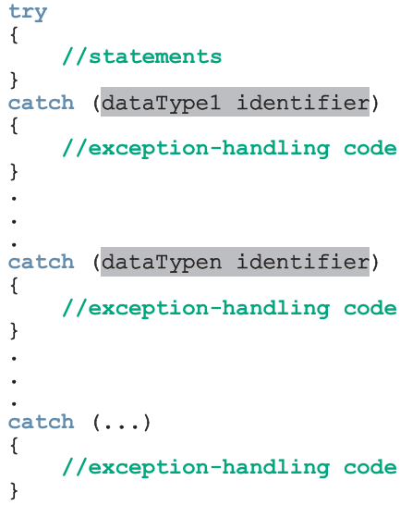
Exception Handling Overview
try/catch block
If no exception is thrown in a try block, all catch blocks are skipped, and execution continues after them.
If an exception is thrown, the rest of the try block is skipped, and the program checks each catch block in order for a match. The first matching catch block runs, and the others are ignored.
A catch(...) block catches any type of exception as a last resort.

Slide 7
Exception Handling Overview
int main()
{
int dividend, divisor, quotient;
try{
cout << "Line 3: Enter the dividend: ";
cin >> dividend;
cout << endl;
cout << "Line 6: Enter the divisor: ";
cin >> divisor;
cout << endl;
if (divisor == 0)
throw 0;
quotient = dividend / divisor;
cout << "Line 12: Quotient = " << quotient << endl;
}
catch (int){
cout << "Line 14: Division by 0." << endl; //Line 14
}
return 0;
}

Slide 8
Exception Handling Overview
Sample Run 1:
Line 3: Enter the dividend: 17
Line 6: Enter the divisor:8
Line 12: Quotient = 2
Sample Run 2:
Line 3: Enter the dividend:
Line 6: Enter the divisor:0
Line 14: Division by 0.

Slide 9
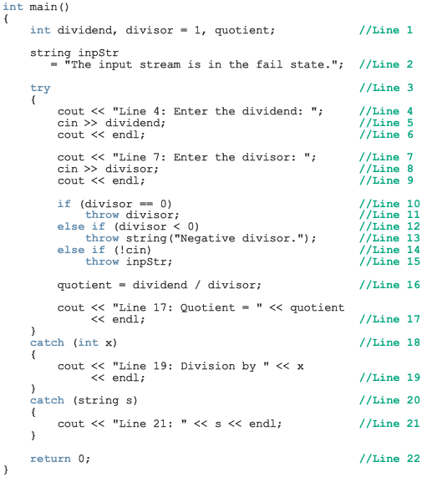
Exception Handling Overview

Slide 10
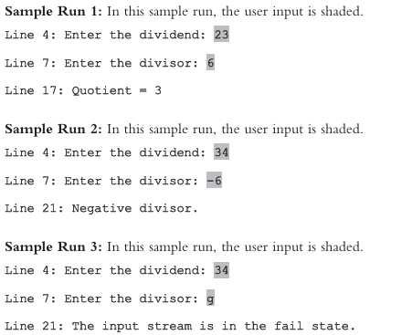
Exception Handling Overview

Slide 11
Exception Handling with Classes
C++ provides support to handle exceptions via a hierarchy of classes.
The class exception is the base of the classes designed to handle exceptions.
Exception class contains the function what. The function what returns a string containing an appropriate message.
All derived classes of the class exception override the function what to issue their own error messages.

Slide 12
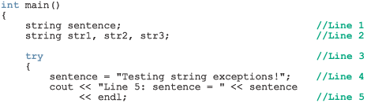
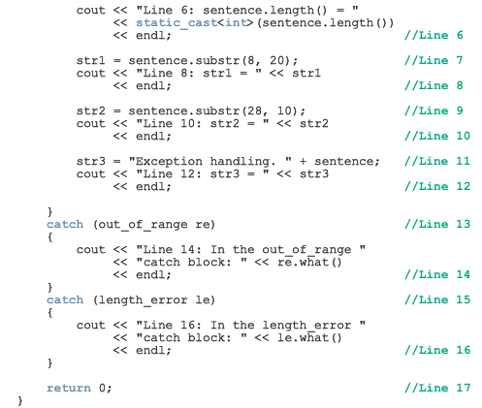
Exception Handling - Handling out_of_range & length_error exceptions

Slide 13

Exception Handling - Handling out_of_range & length_error exceptions

Slide 14
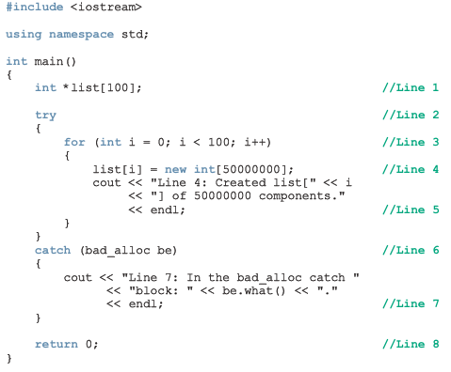
Exception Handling - Handling bad_alloc exception thrown by the operator new

Slide 15
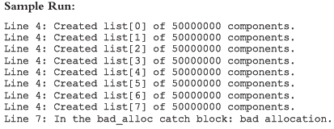
Exception Handling - Handling bad_alloc exception thrown by the operator new

